Slide 1


Ubong Ntekim
4/12/2023

Slide 2

Outline
Executive Summary 3
Introduction 4
Methodology 5 - 16
Insight drawn from EDA 17 - 33
Launch Sites Proximities Analysis 34 - 37
Build a Dashboard with Plotly Dash 38 - 41
Predictive Analysis (Classification) 42 - 44
Conclusion 45

Slide 3
Executive Summary
Summary of methodologies
The data in this report has been collected using public sources. Used Space X application interface (API) to get core data. Other data is obtained via web scraping Wikipedia. The data is explored using structured query language and visualization in the form of geographic maps. Subsequently, tables with columns containing important characteristics were selected. By means of one-hot encoding, the categorical variables are transformed into binary variables. A label that reflects successful landings of Space X launches was defined. After the data is standardized, Grid-Search was applied to find the best variables for Machine Learning models. The accuracy score of all models are included in this report.
Summary of all results
Four machine learning models were applied to the data: Logistic Regression, Support Vector Machine, Decision Tree Classifier, and K Nearest Neighbours. All produced similar results with accuracy rate of about 83.33%. All models predicted successfully landings more data is needed for better model determination and accuracy.

Slide 4
Introduction
Project background and context
Space_X advertises Falcon 9 rocket launches on its website, with a cost of 62 million dollars; other providers cost upward of 165 million dollars each, much of the savings is because SpaceX can reuse the first stage.
Space_N wants to determine if the Falcon 9 first stage will land successfully assuming that we can determine the cost of a launch. This information can be used if an alternate company wants to bid against SpaceX for a rocket launch.
Problems statement
Can Space_N make use of data from available resources to train machine learning models that can predict a successful launch and recovered landing of the first stage.

Slide 5

Section 1

Slide 6
Methodology
A. Data collection methodology:
Data was collected from two public resources Space X public API and Wikipedia.
B. Performed data wrangling:
Transformed data from categorical to binary variables to classify successful and unsuccessful Space X landings.
C. Performed exploratory data analysis (EDA) using visualization and SQL:
Used IBM Watson Studio DB2 cloud service to set up a Database. Created a Python integration and queried tables from database with Structured Query Language to draw insights.
D. Perform interactive visual analytics using Folium:
Folium is a library in Python that helped visualize Space X launch sites and key location.
E. Performed predictive analysis using classification models
Applied Logistic Regression, Support Vector Machine, Decision Tree and KNN, achieved increased machine learning model performance with Grid-Search.

Slide 7
Data Collection Overview
Data collection Process
Is a combination of a call requests to the public Space X API and web scraping Space X data on Wikipedia.
In the following slides flowcharts are used to visualize data collection process.
Data columns from Space X API
The data columns that were extracted from Space X API are;
Flight Number, Date, Booster Version, Payload Mass, Orbit, Launch Site, Outcome, Flights, Grid Fins,
Reused, Legs, Landing Pad, Block, Reused Count, Serial, Longitude, Latitude
Data columns from Web scraping
Flight No., Launch site, Payload, Payload Mass, Orbit, Customer, Launch outcome, Version Booster, Booster landing, Date, Time

Slide 8
Data Collection- SpaceX API
Get data via API call Request to Space X
Applied filter to Data Frame for Falcon 9 launches only
Calculated the MEAN of Payload Mass as input for missing values
Data Collection via Space X API
https://github.com/ubongn/IBM_Data_Science_Professional_Certification/blob/master/Applied%20Data%20Science%20Capstone/Data%20Collection%20API.ipynb.
Created a list of launchsites, BoosterVersion and Payload data using JSON
Converted dictonary to a Data Frame
Normalized data in JSON file coverted file into Data Frame
Extracted core data transformed it into a dictonary

Slide 9
Data Collection- Web scrapping
Executed call request to Wikipedia HTML
Cast HTML Table to Data Frame
Data Collection with
Web Scraping
https://github.com/ubongn/IBM_Data_Science_Professional_Certification/blob/master/Applied%20Data%20Science%20Capstone/Complete%20the%20Data%20Collection%20with%20Web%20Scraping%20lab.ipynb.
Used BeutifulSoup library to parse HTML data to table
Extract data by interating through Data Frame
Detected launch information in HTML table
Created a dictionary from extracted data

Slide 10
Data Wrangling
Data wrangling is the process of cleaning and unifying datasets ready for analysis.
During this process a label is created for training data sets with (1) for successful landing outcomes and (0) for failed landing outcomes.
Mission Outcome and Landing Location are target columns that are supportive to the landing outcomes.
Finally a new label column called Class is added with value (1) for successful and (0) for failed Mission Outcomes. https://github.com/ubongn/IBM_Data_Science_Professional_Certification/blob/master/Applied%20Data%20Science%20Capstone/Data-Wrangling.ipynb

Slide 11
EDA with Data Visualization
EDA stands for Exploratory Data Analysis this process starts with initial investigation on the data.
The Flight Number column (indicates the continuous launch attempts) and Payload are variables that could affect the Landing Outcome. After plotting this two variables in a scatter plot observe that as Flight Number increases, the first stage in more likely to land successfully. It seems that as the Payload increases the less likely the firs stage will return.
Other variables that were plotted and analysed are: Flight Number and Launch Site, Payload and Launch Site, Orbit and Success Rate, Flight Number and Orbit, Payload and Orbit, and a yearly trend of Succeed launches.
Obtained preliminary insights on the relationship of variables, and how they would effect the landing success rate.
Feature engineering refer to the process of selecting and transforming relevant variables from raw data when creating a predictive model. The features that are used to predict the success rate of launches are: 'FlightNumber', 'PayloadMass', 'Orbit', 'LaunchSite', 'Flights', 'GridFins', 'Reused', 'Legs', 'LandingPad', 'Block', 'ReusedCount', 'Serial’. Github Url

Slide 12
EDA with SQL
To gather some information about the dataset, some SQL queries were performed. SQL queries performed are for :- • Display the names of the unique launch sites in the space mission. • Display 5 records where launch sites begin with the string ‘CCA’. • Display the total payload mass carried by boosters launched by NASA (CRS) • Display the average payload mass carried by booster version F9 v1.1 • List the date when the first successful landing outcome on a ground pad was achieved. • List the names of the boosters which had success on a drone ship and a payload mass between 4000 and 6000 kg • List the total number of successful and failed mission outcomes. • List the names of the booster versions which have carried the maximum payload mass. • List the failed landing outcomes on drone ships, their booster versions, and launch site names for 2015. • Rank the count of landing outcomes (such as Failure (drone ship) or Success (ground pad)) between the date 2010-06-04 and 2017-03-20, in descending order. Github Url

Slide 13
Build an Interactive Map with Folium
The success rate of a launch depends on a many factors such as payload, orbit type or flight number. It may also depend on location and launch site proximities.
Building a Launch Site involves many factors in this part we want to discover these factors by analysing the existing Launch Site locations.
Folium library is used to create geographic maps, launch sites are marked with a circle, based on launch records. The success rate of a launch location is marked with (1) green and (0) red for failed launches. A drawn line on the map displays the distances between Launch Site proximities.
The locations analysis gives better insights on the launch site and understanding of his proximities. https://github.com/ubongn/IBM_Data_Science_Professional_Certification/blob/master/Applied%20Data%20Science%20Capstone/Interactive%20Visual%20Analytics%20with%20Folium.ipynb

Slide 14
Build a Dashboard with Plotly Dash
Built an interactive dashboard with plotly dash by plotting a pie chart showing the total launches and sites. After selecting a drop down menu the distribution of successful landings and success rate of a Launch Site is shown a pie chart visual.
The Scatter plot takes two input variables, the selected Launch Site and Payload.
The Payload variable is captured in a slide bar for dynamic selection of mass between 0 and 10000 kilograms.
The Scatter plot visualize how successful landings (Class 0 and 1) vary across launch sites, payload and respective Booster version category.
https://github.com/ubongn/IBM_Data_Science_Professional_Certification/blob/master/Applied%20Data%20Science%20Capstone/spacex_dash_app.py

Slide 15
Predictive Analysis (Classification)
Add column ‘’Class’’ to dataset
Calculate Accuracy Score of objects on test dataset
Applied a Confusion matrix on all objects
Perform exploratory Data Analysis and determine Training Labels
https://github.com/ubongn/IBM_Data_Science_Professional_Certification/blob/master/Applied%20Data%20Science%20Capstone/Machine%20Learning%20Prediction.ipynb
Transform , standardize and fit features into Data Frame with Standard Scaler
Used GridSearch on Logistic Regression, SVM, Decision Tree and KNN object
Visualize accuracy of all objects in a Barchart
Split data into
80% Training
20% Test
Created objects and used GridSearch to find best parameters

Slide 16
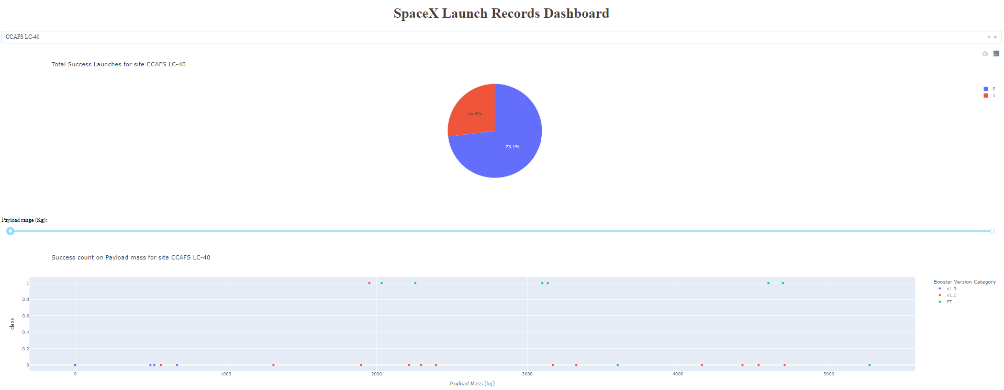
Results
A print screen of the final dashboard is shown below. At the central top there is a opportunity to select a Launch site.
The slide bar with dynamic selection for Payload is shown in the middle of the dashboard.
On the bottom a Scatter plot captures the success rate count in combination with Payload and respective.

Slide 17

Section 2

Slide 18
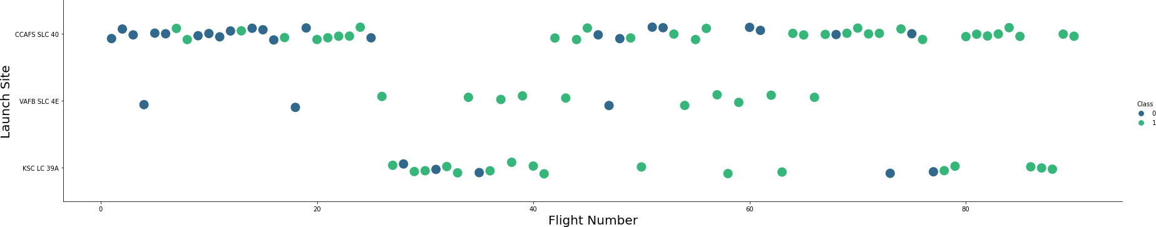
Flight Number vs. Launch Site
The Scatter Plot shows the relationship between Flight Number and Launch Site. The Green dots represent successful and Purple dots a unsuccessful launch.
The plot shows that flights are launched from different sites. With an interval of approximal 20 flights per Launch Site.
The Launch Sites have different success rates CCAFS LC-40 has a success rate of 66% while KSC LC-39A and VAFB SLC 4E has a success rate of 77%.
Most Flights (number) are launched from site CCAFS LC-40 therefore appear to be a main Launch Site.

Slide 19
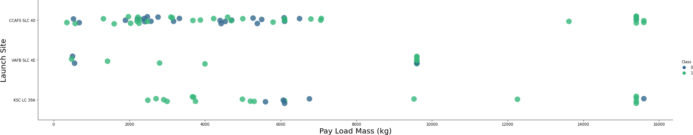
Payload vs. Launch Site
The Scatter Plot shows the relationship between Payload and Launch Site. The Green dots represent successful and Purple dots a unsuccessful launch.
The plot shows that for Launch Site VAFB-SLC 4E there are no rockets launched for heavy payload greater than 10.000 kilograms.
The Payload of the majority of rockets launched is between 0 and 6.000 kilograms.
It seems that the Launch Sites have a variety of Payload used during launch.

Slide 20
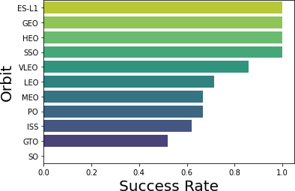
Success Rate vs. Orbit Type
Success Rate Scale:
0 as 0%
0.6 as 60% 1 as 100%
The bar chart shows the relationship between Success Rate and Orbit type.
Orbit ES-l1, GEO, and HEO have a success rate of 1 is equal to 100% with a sample size of (1) launch.
SSO orbit have a success rate of 1 is equal to 100% with a sample rate of (5) launches.
GTO orbit have a success rate of 50% with the largest sample rate of (27) launches.
Finally SO not a successful orbit as it have an success rate of 0 equal to 0%.

Slide 21
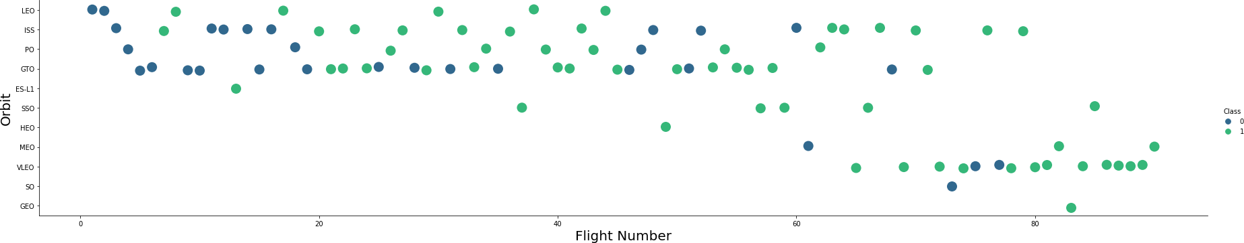
Flight Number vs. Orbit Type
The Scatter Plot shows the relationship between Flight Number and Orbit Type. The Green dots represent successful and Purple dots a unsuccessful launch.
The plot shows that in LEO Orbit the Success appears related to flights; on the other hand, there seems to be no relationship between flight number when in GTO Orbit.
There is a relationship between LEO and VLEO as SpaceX started with LEO and after success continued with VLEO.
The launches of Space X perform better at low Orbits or Sun-synchronous Orbit meaning that the distance between Earth and Orbit is approx. 200 to 1,000 km.

Slide 22
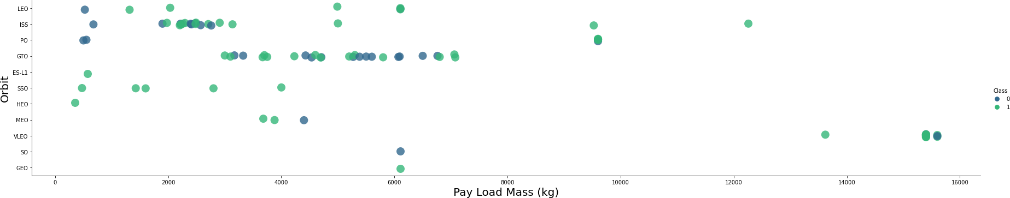
Payload vs. Orbit Type
The Scatter Plot shows the relationship between Payload and Orbit Type. The Green dots represent successful and Purple dots a unsuccessful launch.
There is a clear relation between Payload and Orbit type.
Launches with a heavy Payload will succeed with LEO, ISS and Polar (PO) Orbits.
It is difficult to determine the success of GTO Orbit as it has positive and negative launches.

Slide 23
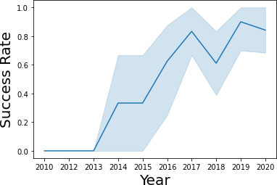
Launch Success Yearly Trend
The Line chart above shows the average launch trend on year basis.
The success rate increases yearly as from 2013.
In 2018 the success rate drops and return back to 80% average for the year after.

Slide 24
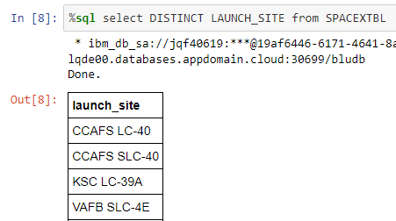
All Launch Site Names
The SQL query above is executed using DISTINCT to extract all site names from a SQL DBS cloud database created for this project.
CCAFS SLC-40 and CCAFSSLC-40 represent launch site with data errors.
CCAFS LC-40 was the previous name of site CCAFSSLC-40.
Overall there are 3 distinct unique launch sites.

Slide 25
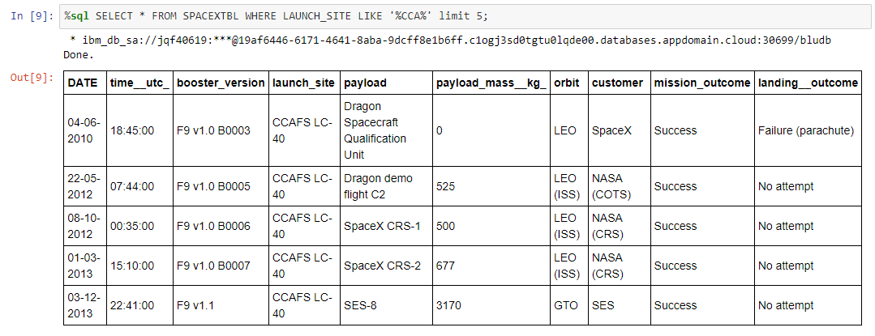
Launch Site Names Begin with 'CCA'
The print screen a above is a SQL query that shows the launch sites in the database beginning with ‘’CCA’’.

Slide 26
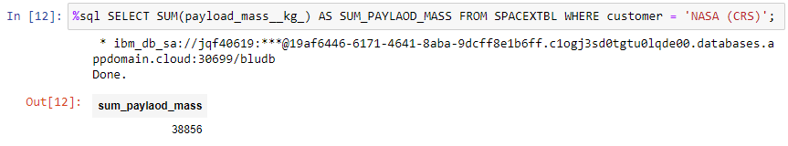
Total Payload Mass
The print screen a above is a SQL query that display the total payload mass carried by boosters where NASA is customer.
CRS stands for Commercial Resupply Services this indicates that the launches of NASA were sent to the International Space Station (ISS)

Slide 27
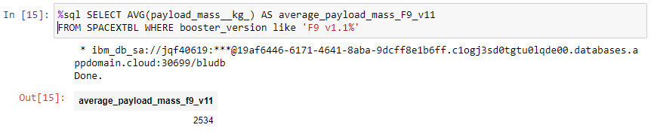
Average Payload Mass by F9 v1.1
The print screen a above is a SQL query with a WHERE CLAUSE displaying the calculated average Payload Mass or Launches where Booster version F9 v1.1. was used.
The average weight of F9 v1.1 Payload Mass is low compared to the Payload Mass range.

Slide 28
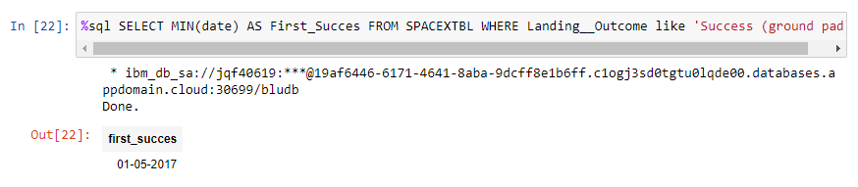
First Successful Ground Landing Date
The print screen above is a SQL query that display the first successful Ground Landing date in history of Space X launches.
Based on the dataset successful landings appear starting from 2018.

Slide 29
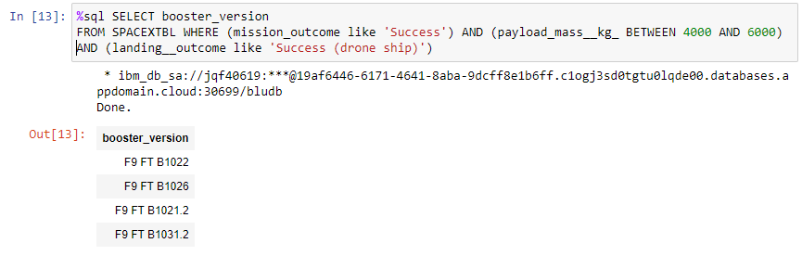
Successful Drone Ship Landing with Payload between 4000 and 6000
The print screen above is a SQL query that display the four booster versions that had successful drone ship landings with a Payload Mass from 4,000 kilogram to 6,000 kilogram.

Slide 30
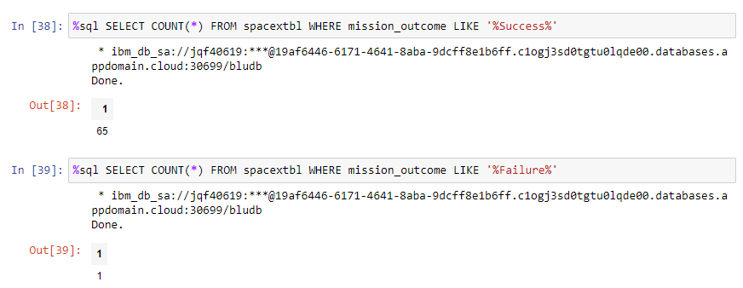
Total Number of Successful and Failure Mission Outcomes
The print screen above is a SQL query that display a count of all mission outcomes.
Space X achieves a success of 99% of the time.
This could mean that most Failure launches are intended.

Slide 31
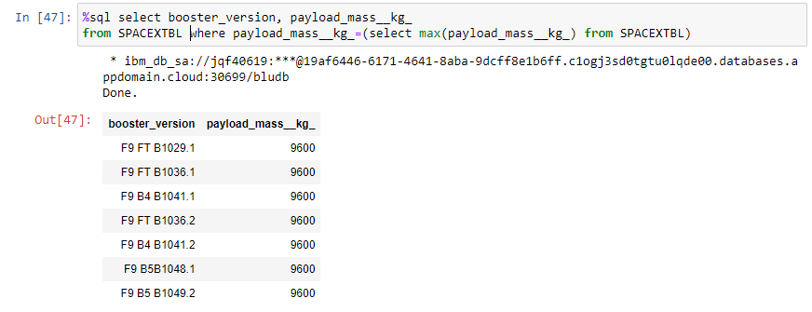
Boosters Carried Maximum Payload
The print screen above is a SQL query that use the WHERE clause and MAX function to display the booster versions that carried the highest Payload.
It seems that all F9 booster version can handle a Payload of maximum 9,600 kilogram.
There is a likelihood that Payload relates to F9 booster versions.

Slide 32
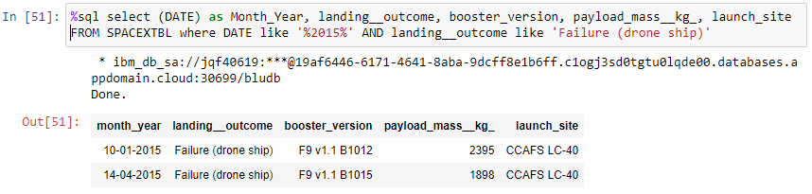
2015 Launch Records
The print screen above is a SQL query use the WHERE clause, LIKE AND, and BETWEEN to display the launch records of 2015 where Stage 1 failed to land on a drone ship.
It seems that all F9 booster version can handle a Payload of maximum 9,600 kilogram.
The query shows two records in 2015.

Slide 33
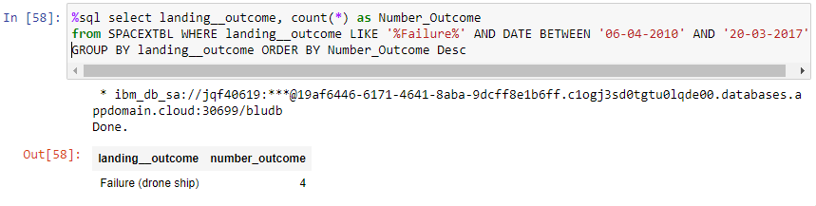
Rank Landing Outcomes Between 2010-06-04 and 2017-03-20
The print screen above is a SQL query that use the COUNT, WHERE clause, BETWEEN, GOUP BY and the ORDER BY clause to display the failed drone ship landings between 2010 and 2017 inclusively.
It seems that there were four failed drone ship landings in that period.

Slide 34

Section 3

Slide 35
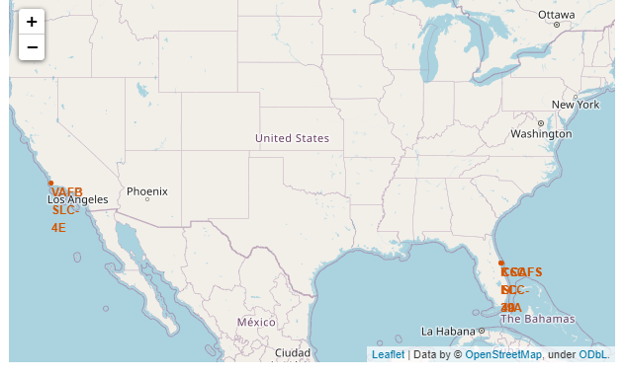
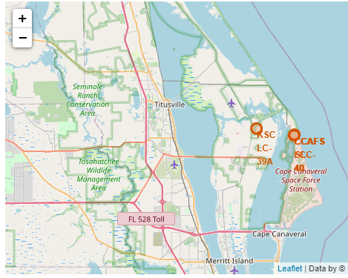
Launch Site Locations
The map on the left side is a global visualization of launch site locations in the United States, on the right is a zoomed visual of the sites in Florida (Orlando).
All Space X locations in the dataset are in the United States.
All launch site location are near the ocean.

Slide 36

Color – Coded Launch Markers
The above is a visualization of a site including color coded launch markers.
With clicks on the map it displays green and red icons indicating successful and unsuccessful landings.
The map shows that launch site VAFB SLC – 4E has six failed and four successful landings.

Slide 37
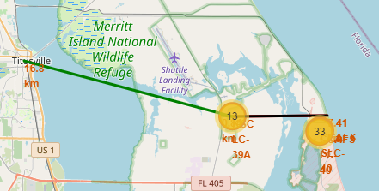
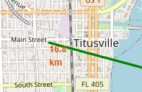
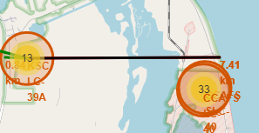
Key locations and Proximities
Observed that KSC LC-39A is a launch site that is close to a railway and close to the coastline. Supply transportation can take place by land via train. This launch site is also close to a highway for human and supply transports. In general launch sites are far away form cities so failure launches can safely land in the sea and not in populated areas.

Slide 38

Section 4

Slide 39


Succesful Launches of all Launch Sies
Observed that KSC LC-39A had with (41%) the most successful launches from all launch sites.

Slide 40

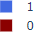
Highest Succes rate of Lauch Site
A close observation shows that launch site KSC LC – 39A achieved a success of 76.9% and a failure rate of 23.1%.

Slide 41

Paylaod Mass vs Succes vs. Booster Version Category
The Scatter Plot shows the relationship between Payload Mass, Success Rate and the Booster Version. Observe that the Success Rate of low weighted Payload is high compared to Booster Versions with a heavy weighted Payload.

Slide 42

Section 5

Slide 43

Predictive Analysis (Classification)
There where four classification models analyzed; KNN, Decision Tree, Logistic Regression and Support Vector Machine. The Decision Tree classifier is the model with the highest (predictive) accuracy.

Slide 44

Confusion Matrix
The Confusion Matrix shows that when the Decision Tree classifier is used to predict. The classifier shows a clear differentiation between predicted classes. The matrix show three false positives that could lead to a error in predictions, because unsuccessful landings could be treated and marked as successful landings.

Slide 45
Conclusions
After completing the Data Science journey the following conclusion can be drawn.
The flight analysis show that when the number of flights increases the effect is a greater success rate for that launch site.
The Success Rate of Space X launches increased in the period 2013 till 2020.
The Orbits with the highest Success Rate are; VLEO, GEO, HEO, SSO, ES-L1.
Launch Site: KSC LC-39 A has the most success launches compared to all sites.
The Decision Tree Classifier is the best performing machine learning algorithm.

Slide 46


